Slide 3
Each Stripe on the raw image becomes a full pushbroom composite
Single angle RGB reconstructed with 469 raw images and 3 wavelengths
Click here for animation

Slide 4
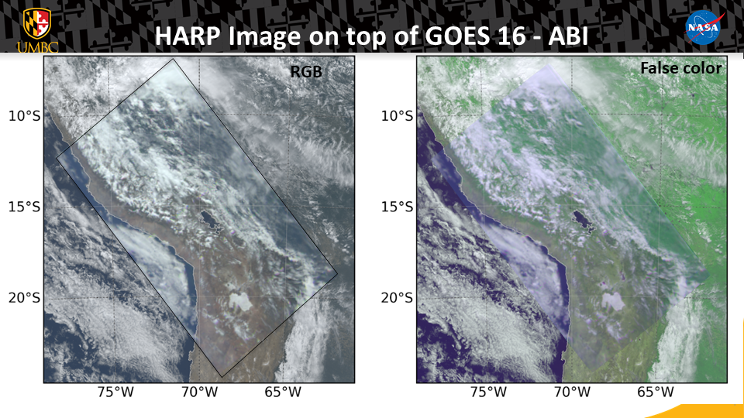

Slide 5
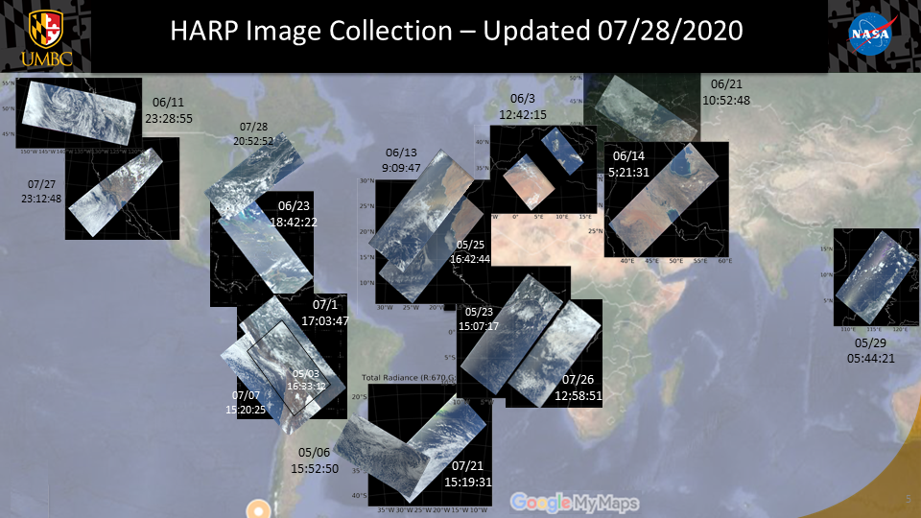

Slide 6
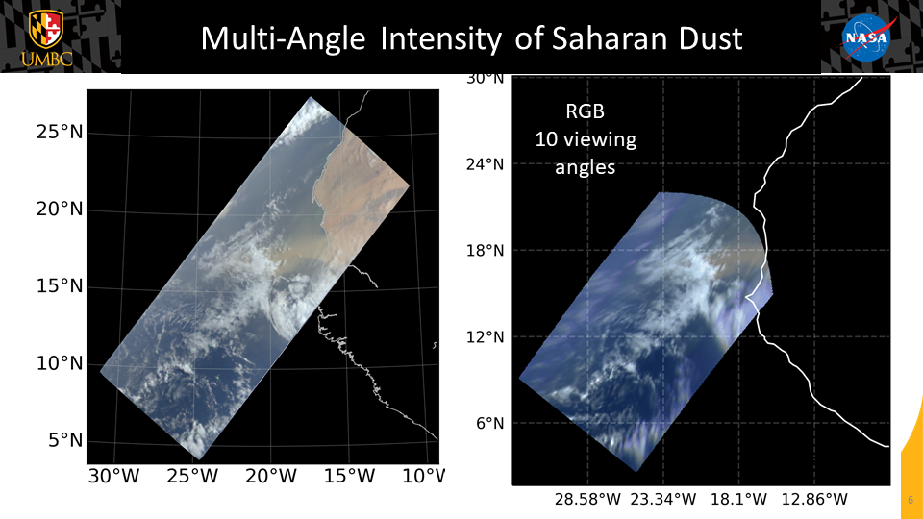
Click here for animation

Slide 7
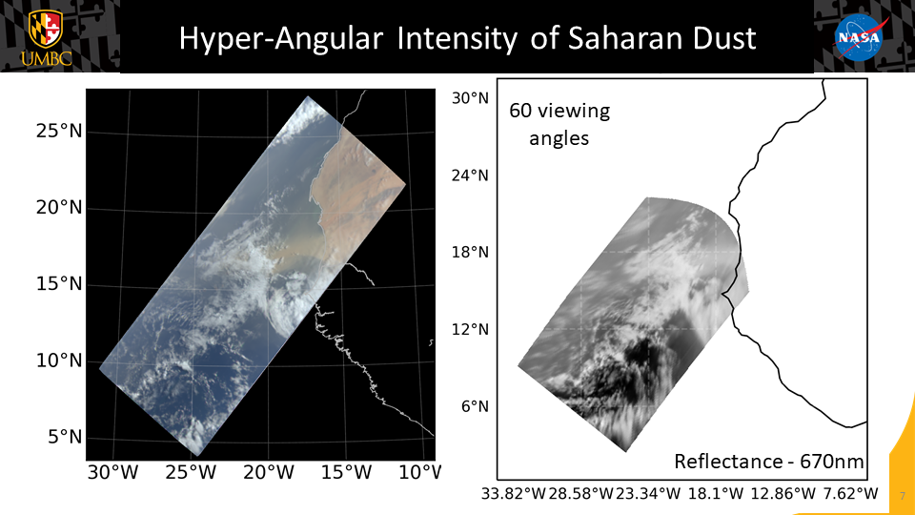
Click here for animation

Slide 12
